Slide 1
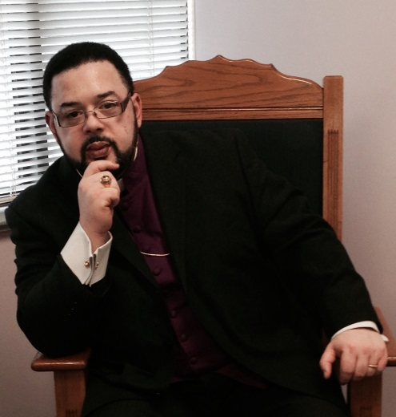
Re-Entry Services:
Mission: The program course involves lessons in positive disciplined thinking, positive speech, critical thinking, job interviewing techniques, resume preparation, and financial management, all to assist individuals in becoming better citizens upon their return to society. This program also addresses the mind, emotions, and heart, positively affecting those who are in the process of transitioning back into society, and to reduce recidivism in Montgomery County, Md.
Healing Yourself Outreach Program TOPICS:
-How to pay off debt
-How to save money
-How to balance your check book
Healing Yourself
Outreach Program:
Objectives: To increase personal integrity and honesty (rooted in respect for the truth); to enhance professional development skills; to provide financial management and fiscal responsibility techniques.

